Slide 1




ANALYSIS OF CODEX
A GERMAN BEVARAGE COMPANY

Slide 2


About CodeX
CodeX is a German beverage company that is aiming to make its mark in the Indian market. A few months ago, they launched their energy drink in 10 cities in India.
Their Marketing team is responsible for increasing brand awareness, market share, and product development. They conducted a survey in those 10 cities and received results from 10k respondents.

Slide 3
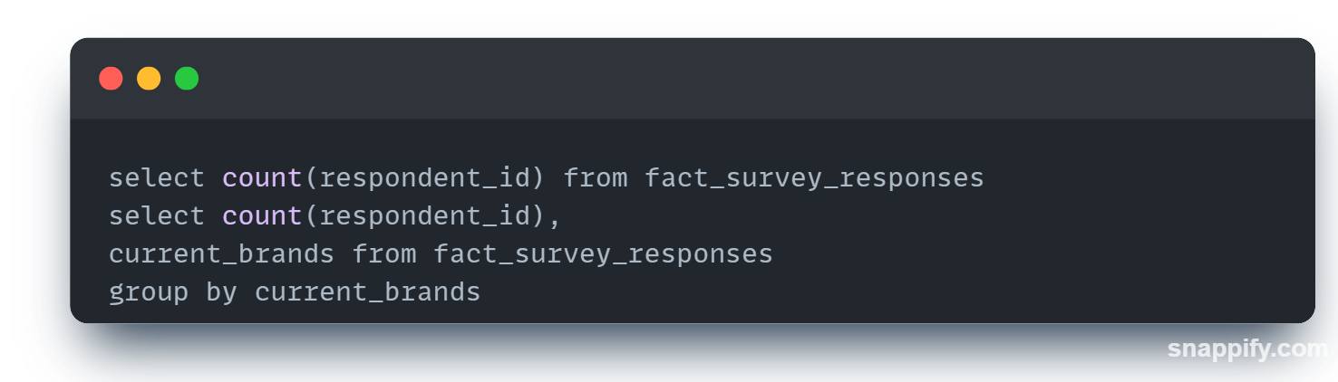
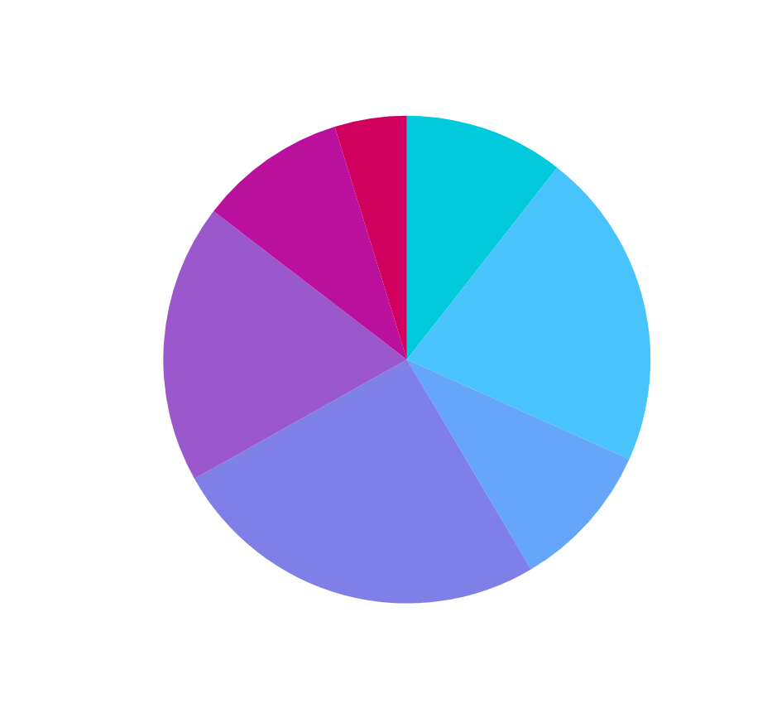
overall Consumers are 10K. Out of Total Consumers There Are total 980 consumers of CodeX which was 9.8% of overall consumers .

Slide 4
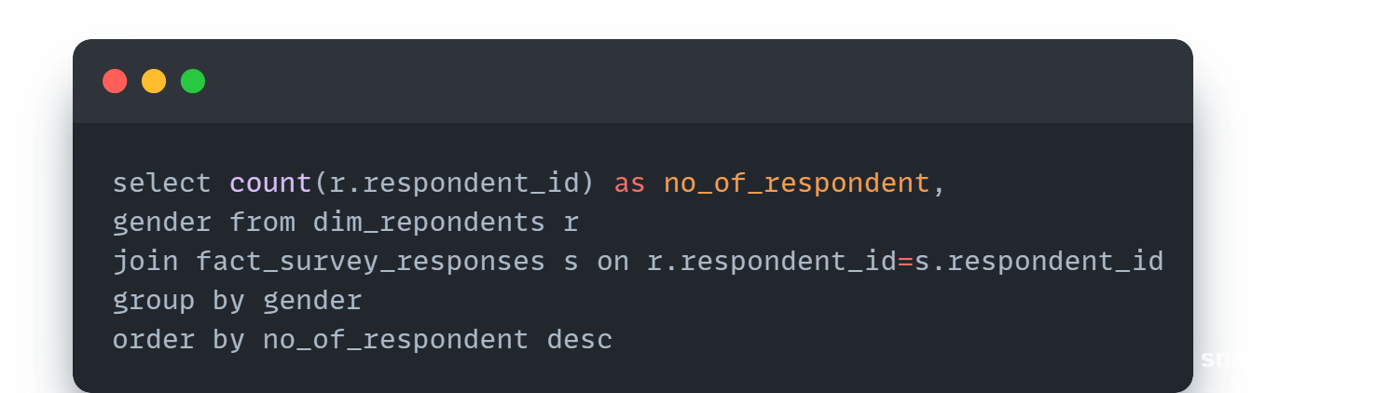

Who Prefers Energy Drink more? (Male/Female/Non-binary?)
6038
3455
Male Consumers are highest in number. that is 6038 and female consumers are 3055 and Non-binary consumers are very less.
507

Slide 5
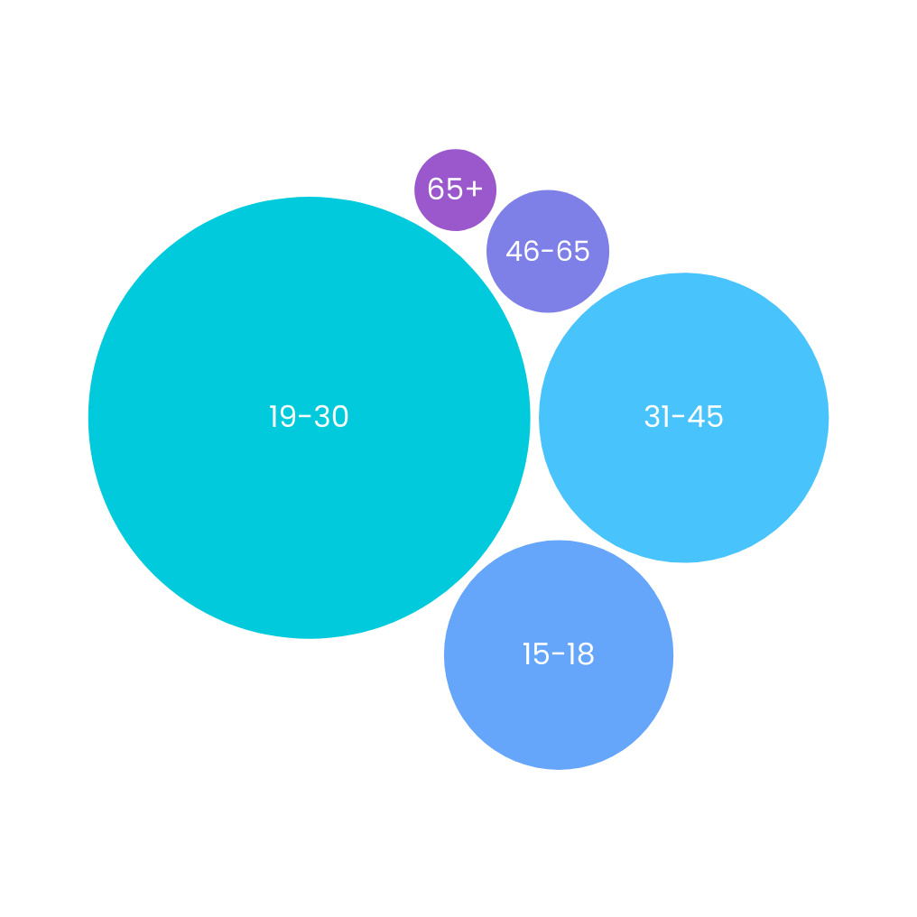
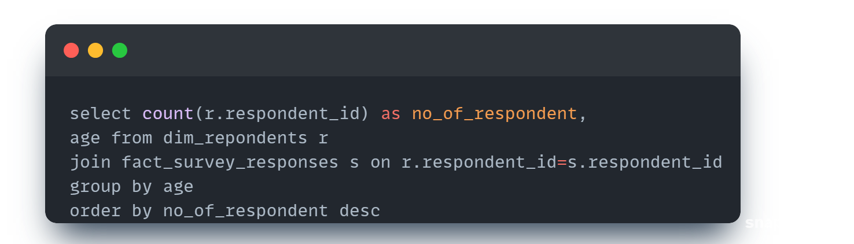
Which age group prefers energy drinks more?
190
426
5520
Out of 10K Consumers. The consumers having Age Group between 19-30 prefers Energy drink more as compared to others.
2376
1488

Slide 6
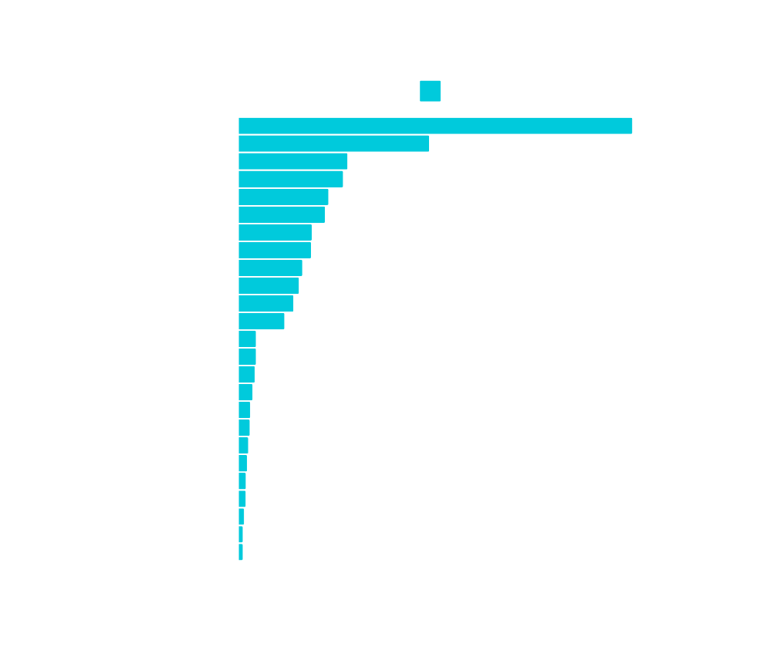
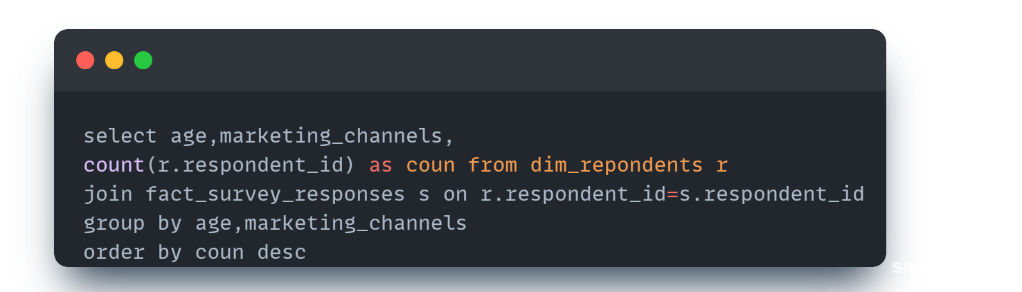
Which type of marketing reaches the most Youth (15-30)?
Here ,Marketing through Online Ads reaches the most Youth having age Group between
15-30

Slide 7

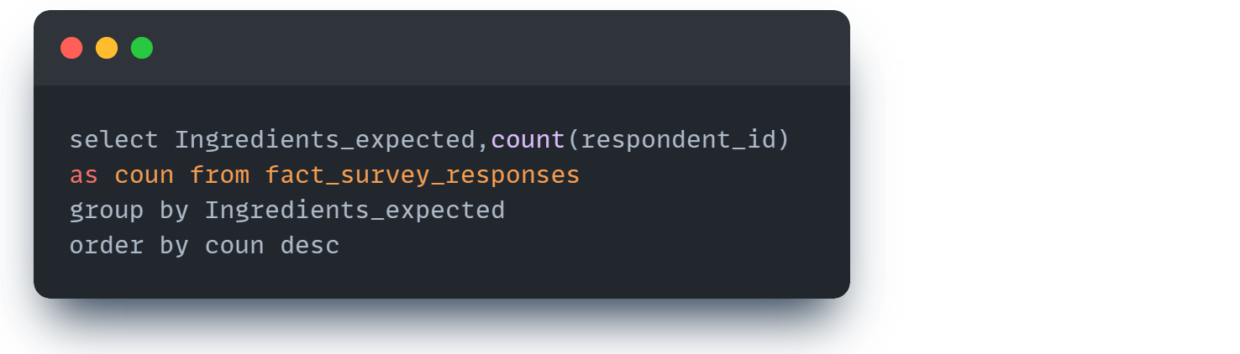
What are the preferred ingredients of energy drinks among respondents?
Caffeine is the most preferred ingredient.

Slide 8


What packaging preferences do respondents have for energy drinks?
Respondents prefer Compact and Portable cans highly as compared to other packaging

Slide 9

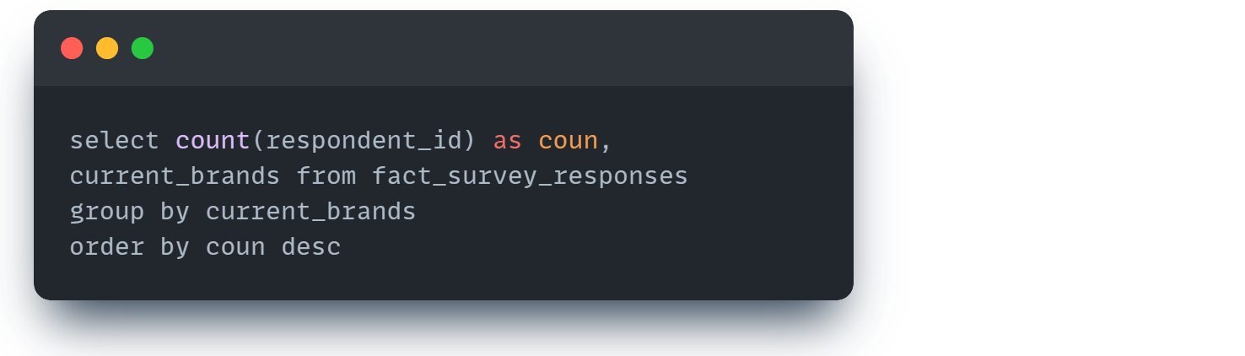
Who are the current market leaders?
Cola-Coka are current top market leaders because it has total 2538 respondents

Slide 10
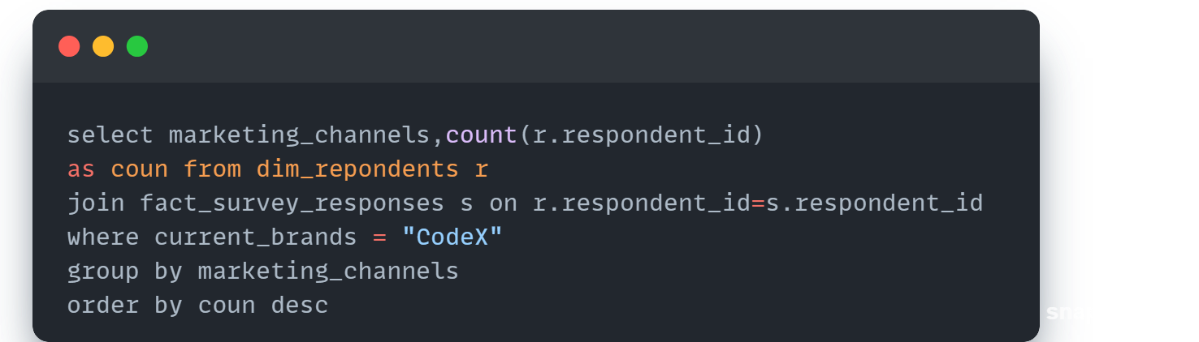
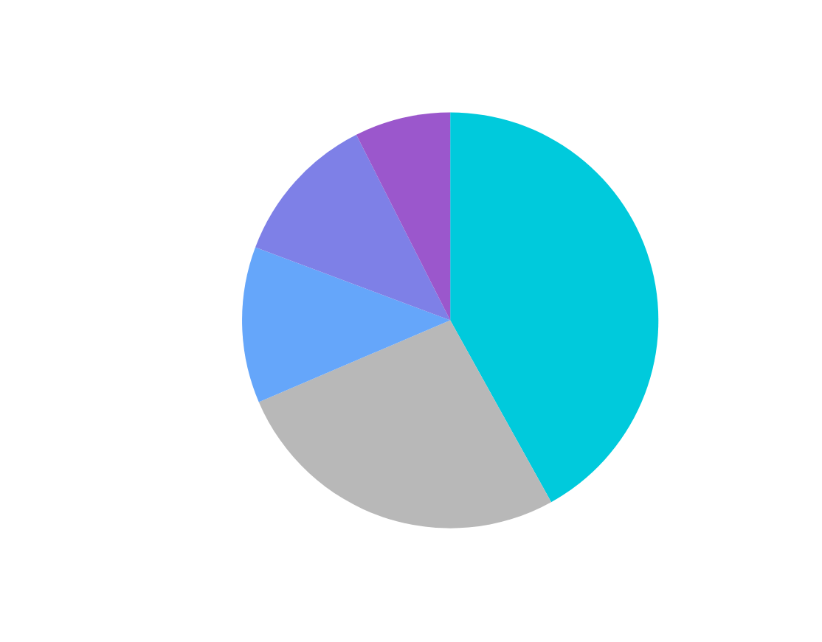
Which marketing channel can be used to reach more customers?
Most of the consumers responded from Online Ads so we use Marketing from Online Ads to reach more customers

Slide 11
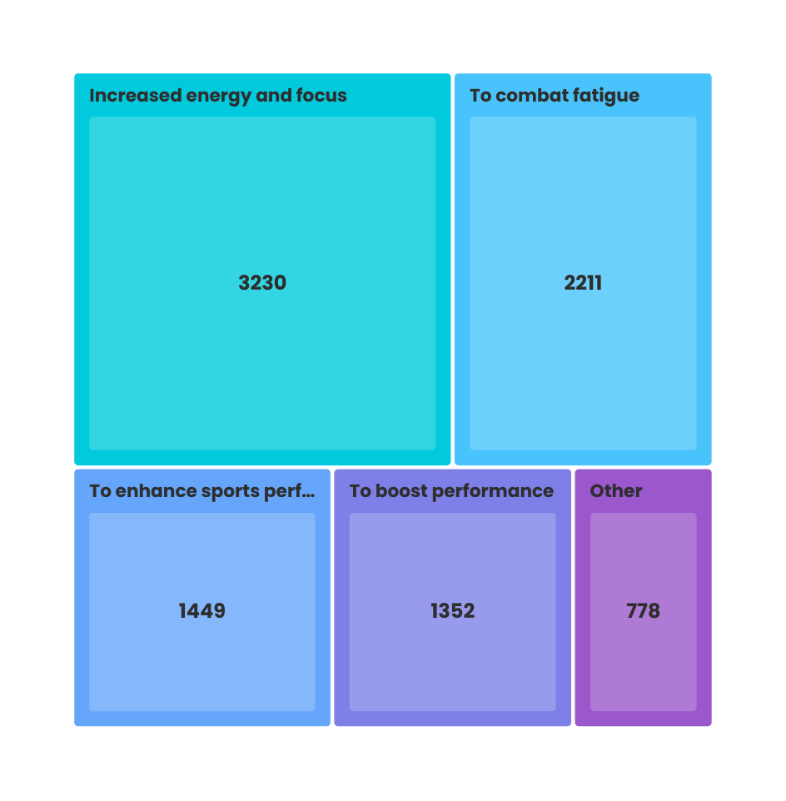
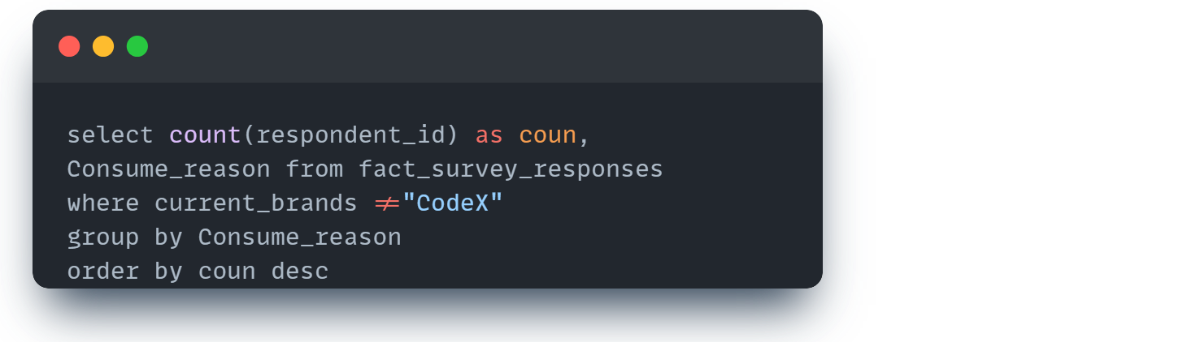
What are the primary reasons consumers prefer those brands over ours?
Consumers prefer other brands rather than CodeX because of their Increased Energy and focus and aso To comfort fatigue.

Slide 12

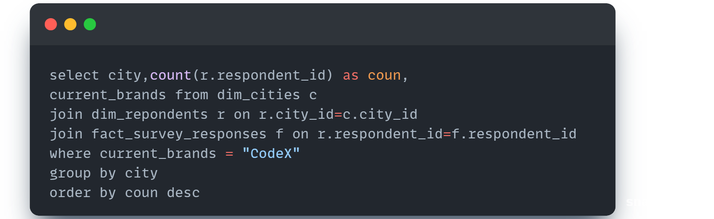
Which cities do we need to focus more on?
Most of the customers are from Bangalore city and Lucknow has very low customers.

Slide 13

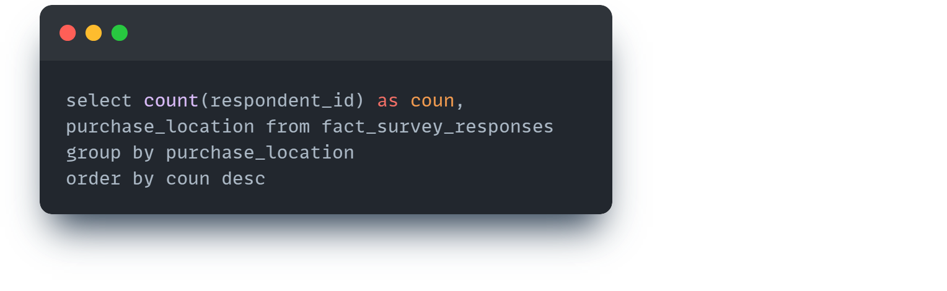
Where do respondents prefer to purchase energy drinks?
Respondents prefer to purchase energy drink from Supermarkets more as compared to other options.

Slide 14
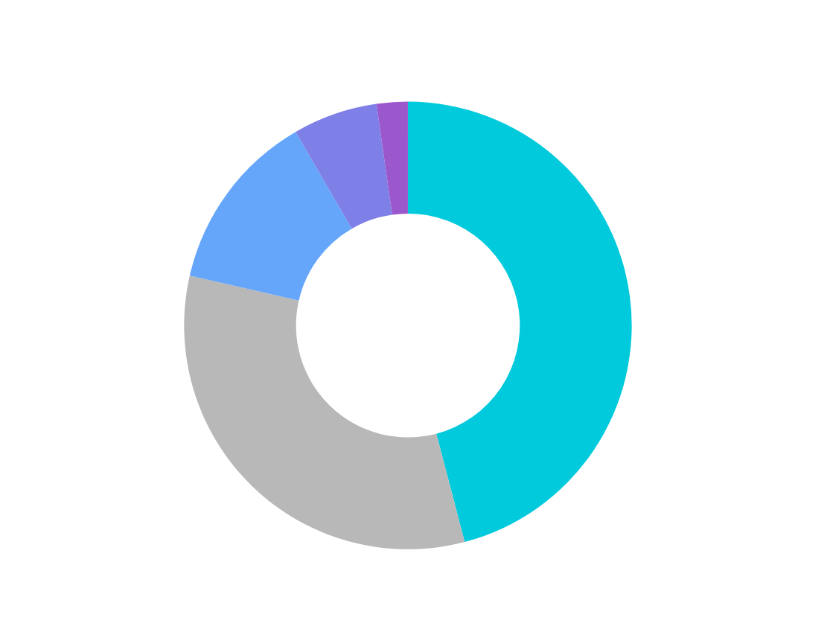
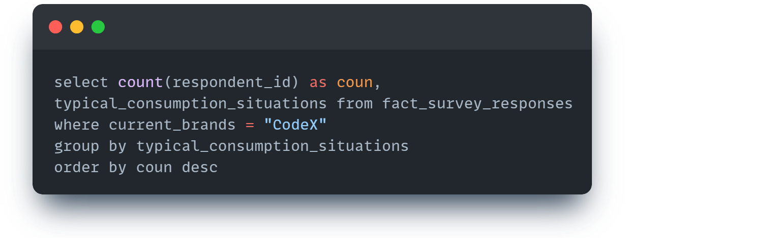
What are the typical consumption situations for energy drinks among respondents?
Consumers From Sports and Excercise consume more energy drinks .like 45% cosumers are from there only.

Slide 15

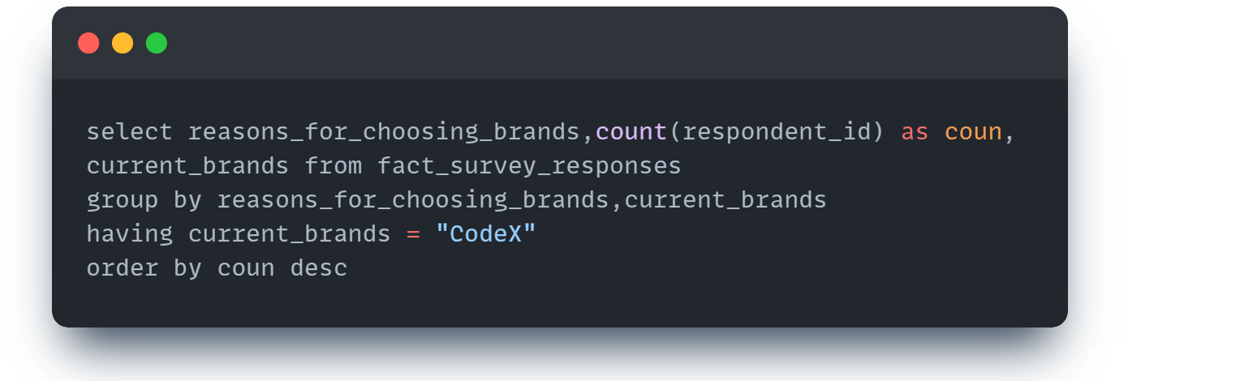
Which area of business should we focus more on our product development? (Branding/taste/availability)
We have to focus more on effectiveness,Taste and Flavor preferences and also availability of our product.

Slide 16
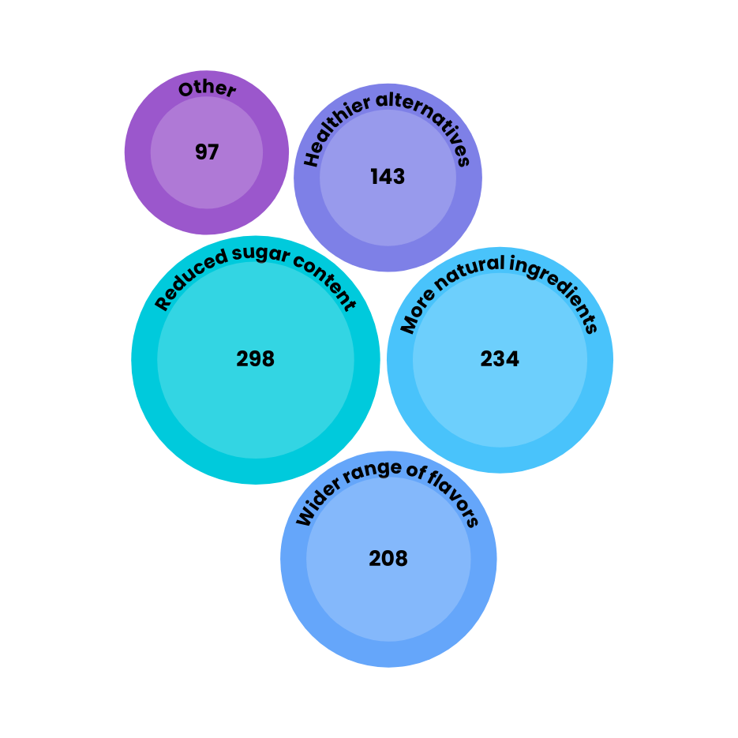
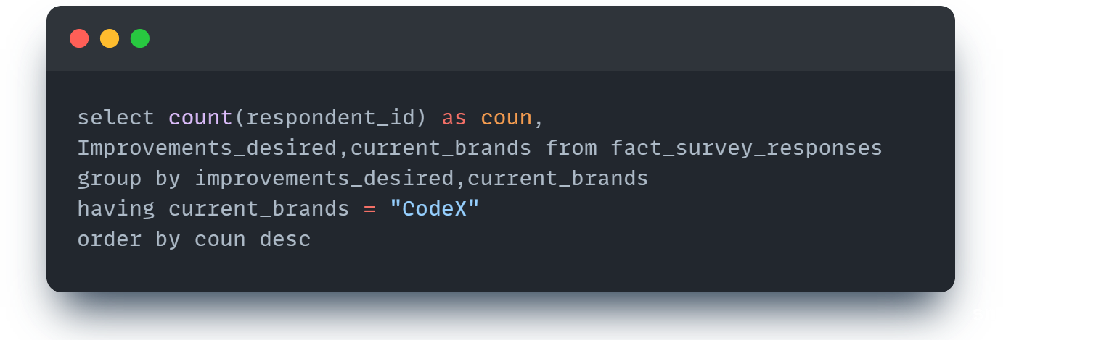
What immediate improvements can we bring to the product?
We need to reduce sugar content in our energy drink and also we need to add more natural ingredients

Slide 17
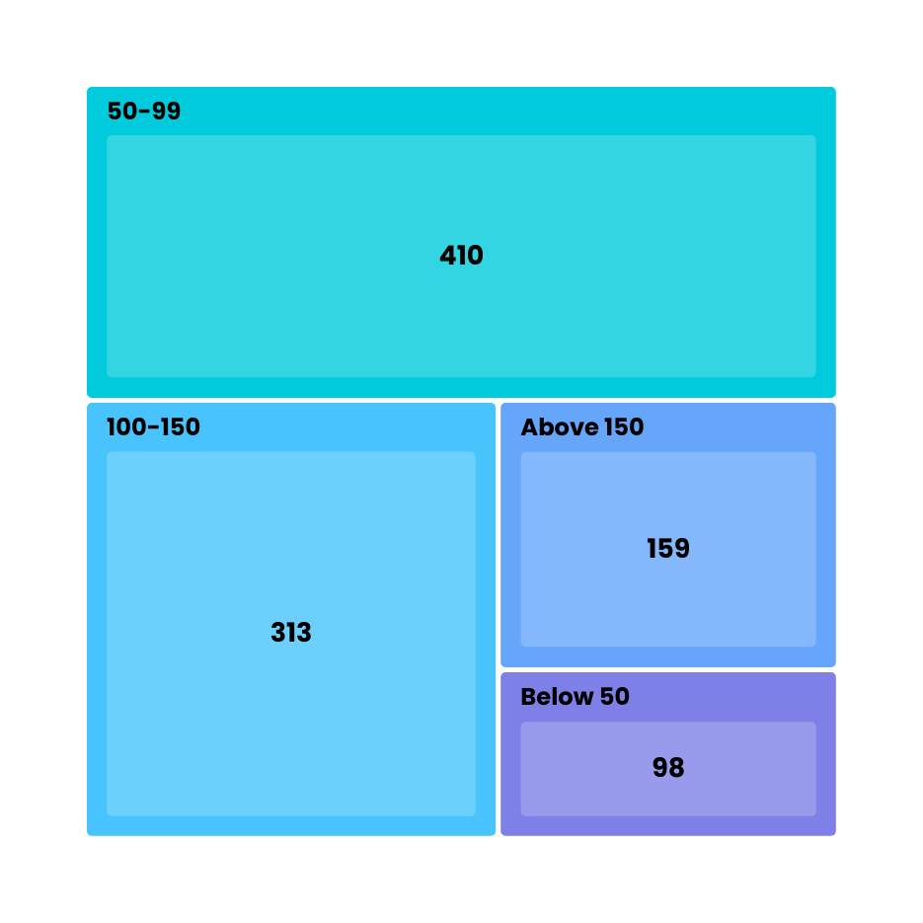
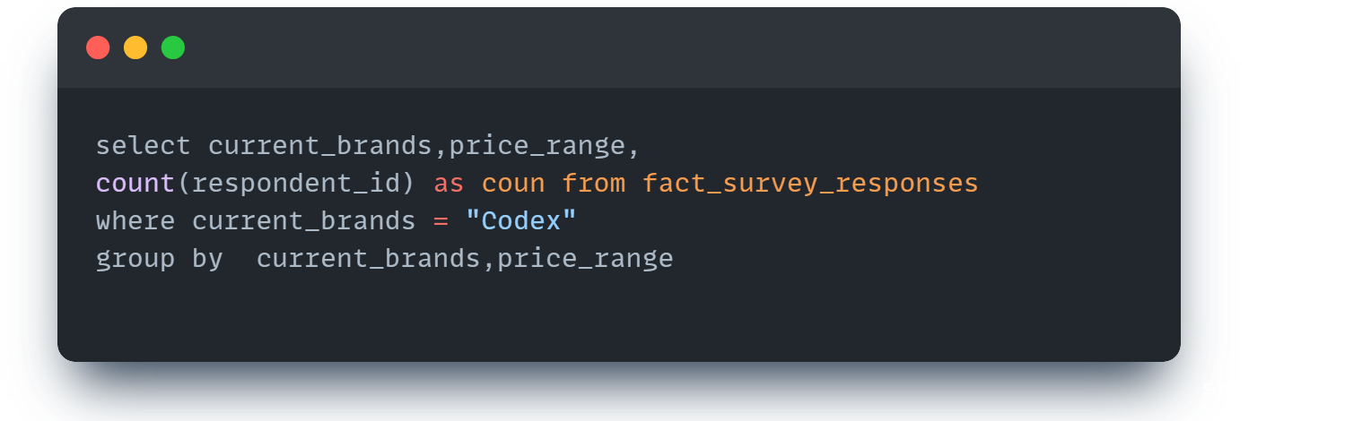
What should be the ideal price of our product?
Customers are high for the energy drink having price 50-99 so this should be the ideal price of our product

Slide 18

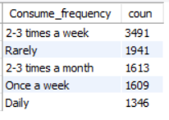

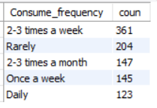
Respondents By Consuming Frequency
For All
For Codex

Slide 19
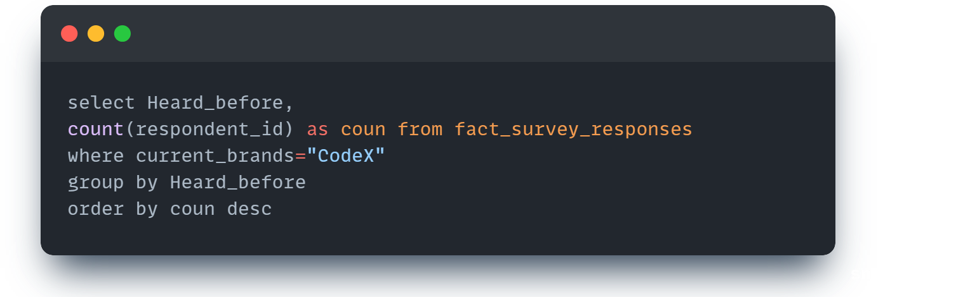
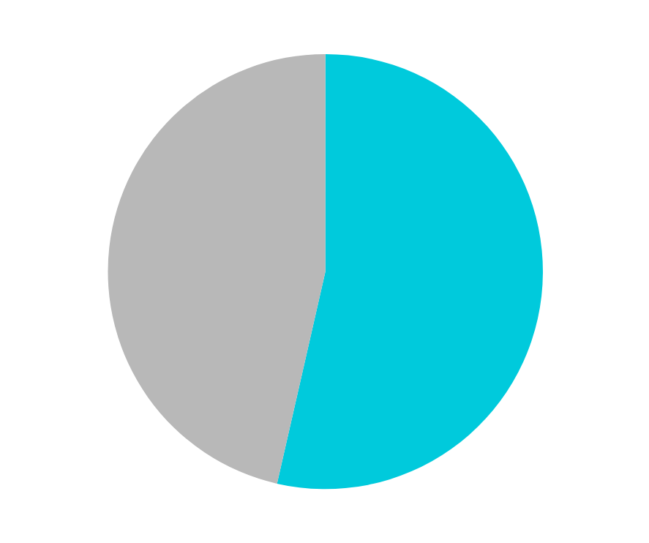
Brand Awareness
Out of 980 Customers only 46% have heard Before about the brand

Slide 20
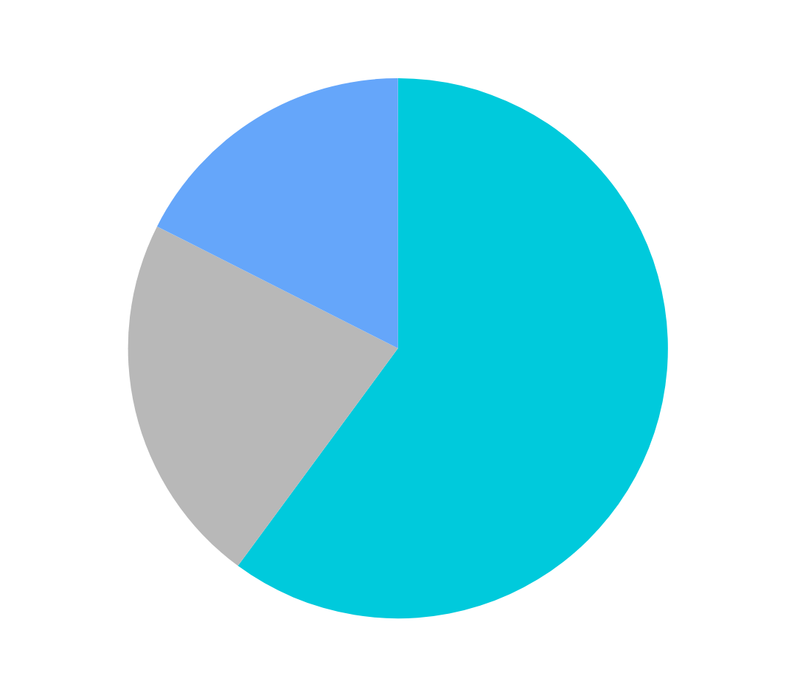
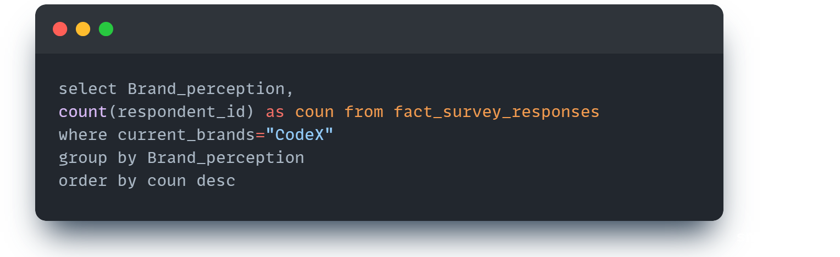
Respondents By Brand Perception
Out of 980 Customers 60% have no opinion about the brand and 22% are Positive and 17% are negative about the brand.

Slide 21
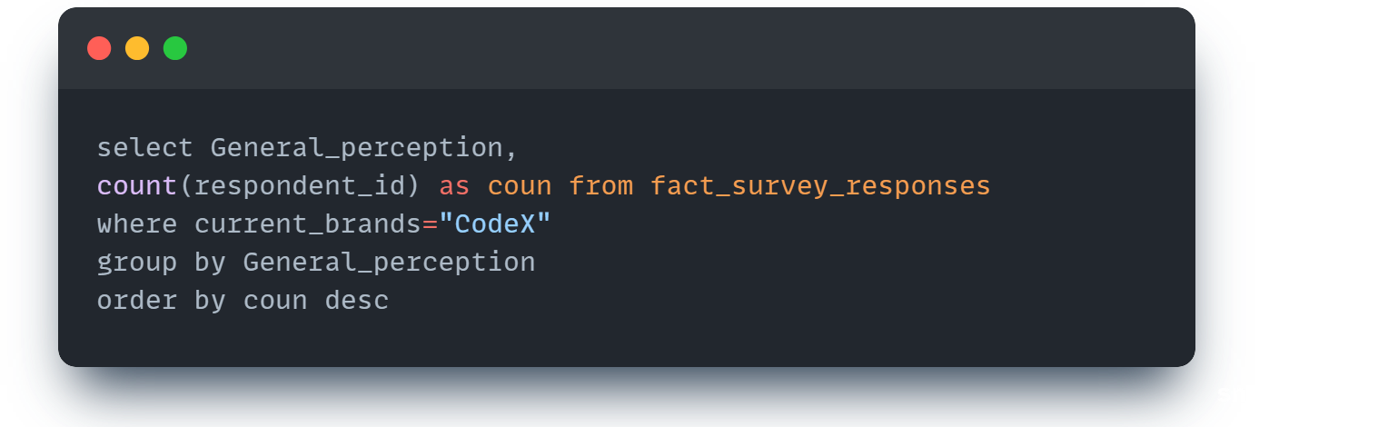
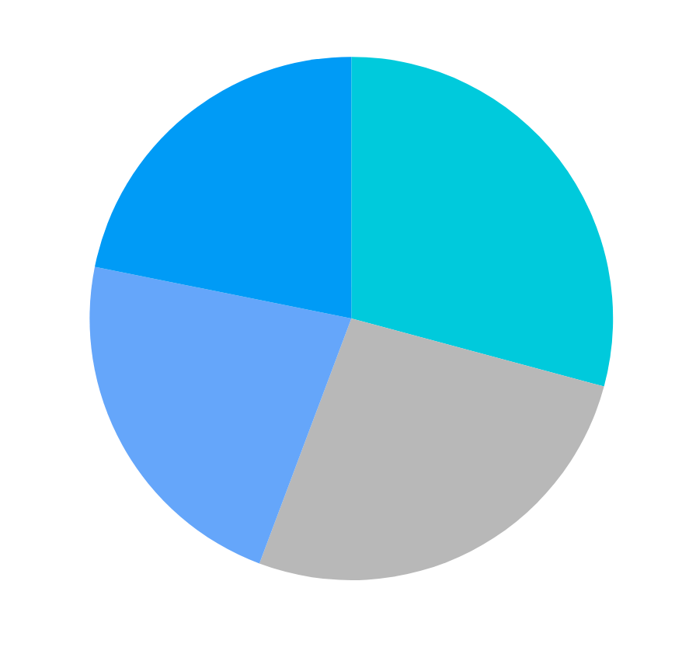
Respondents By General Perception
Out of 980 Customers 29% found our drink effective,26% are not sure ,22% found healthy and 21% found Dangerous .

Slide 22


Recommendations
Develop starategies to increase consumers from cities like Lucknow,Jaipur,Delhi,Ahmdabad
01
02
Focus on increasing cosumers having age group between 19-30.
Take more compaigns to enagage and to attract youth.
03
04
Enhance Brand Awareness through marketing Channels like Online Ads,TV channels.
05
Focus on customer recommendations and do all the processes gradually.

Slide 23



HEMANAND VADIVEL
THANK YOU
FOR THIS WONDERFUL OPPORTUNITY
DHAVAL PATEL

Slide 24



Presented by :-
Ravina Karnik
karnikravina10@gmail.com
Git-Hub Repository

Slide 25

THANK YOU
YOUR FEEDBACK IS HIGHLY APPRECIATED PLEASE SHARE YOUR THOUGHTS IN COMMENT SECTION BELOW

